Slide 1

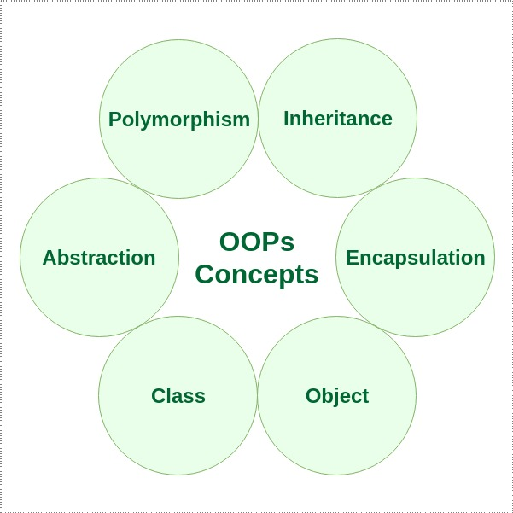
Module 5: Classes and Objects

Slide 2
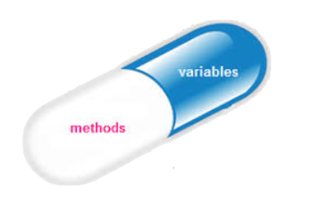

Basic Object-Oriented Concepts
Encapsulation
What you see is what you care (modularity 2.0)
Polymorphism
Same method name, different classes
In other OO languages (Java, C++, etc.) it is different
Inheritance
Superclasses and Subclasses
Code reuse to avoid code replication
Question
Numeric Question
Textual Question

Slide 3
Encapsulation
What happens in a class stays in that class
It includes input parameters passage by value
Same name, different scope => different variable
The implementation is hidden, only the public methods calls are known, that applies to instance variables and the implementation of methods
You can change the class implementation without impact in class' use
Modularity, i.e., the use of functions to reduce complexity also provides encapsulation, but OO is a step further

Slide 4
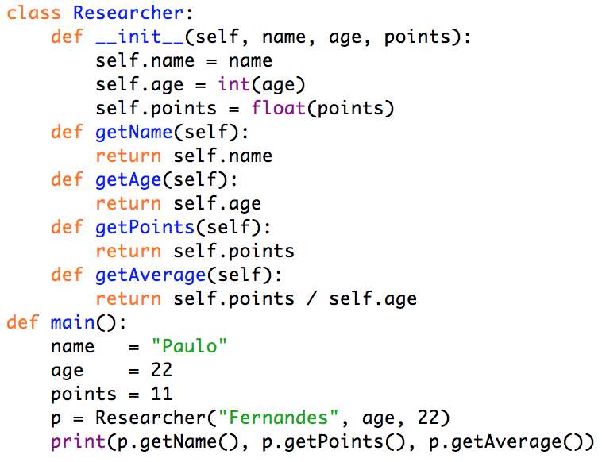
Encapsulation
Same name, different scope => different variable
What will be printed?
Paulo or Fernandes
22 or 11
1.0 or 0.5

Slide 5
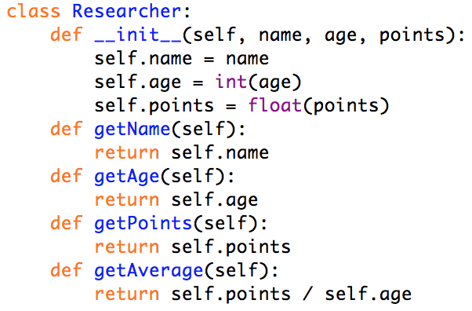
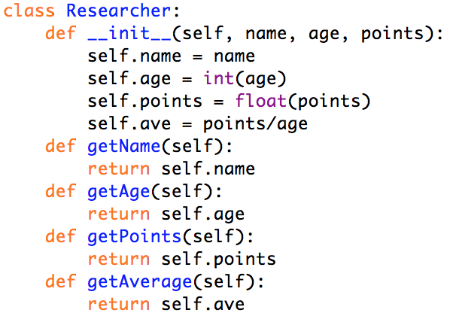
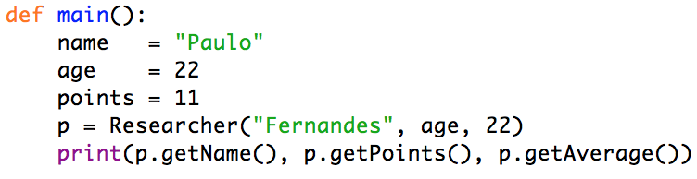

Encapsulation
The implementation is hidden

Slide 6


Polymorphism
Same method, different class => different call
Uniformization of methods among classes
Call to a generic object
The class is an implicit parameter
In other languages it may be different
In C++ there is parameter overload
In Java there is parameter overload, but also:
Generic objects
Interfaces, etc.

Slide 7
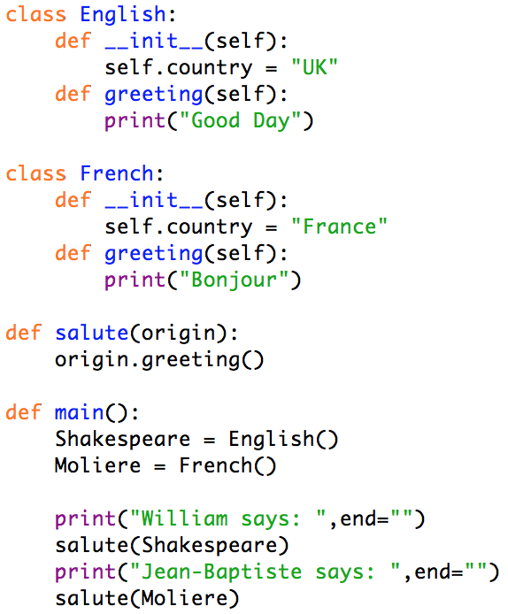

Polymorphism
Same method, different class => different call
What will be the output?

Slide 8
Inheritance
Question
Specialized classes
Superclasses
A Class inherits definitions from a Superclass
Instance Variables
Methods
Constructors from Superclass implicitly called
In case of overload, Superclass one is trumped
Subclasses
A Class inheriting from a Superclass is said to be the Subclass of this more general class
Syntaxe
class <name>(<super class name>):
...
Numeric Question
Textual Question

Slide 9
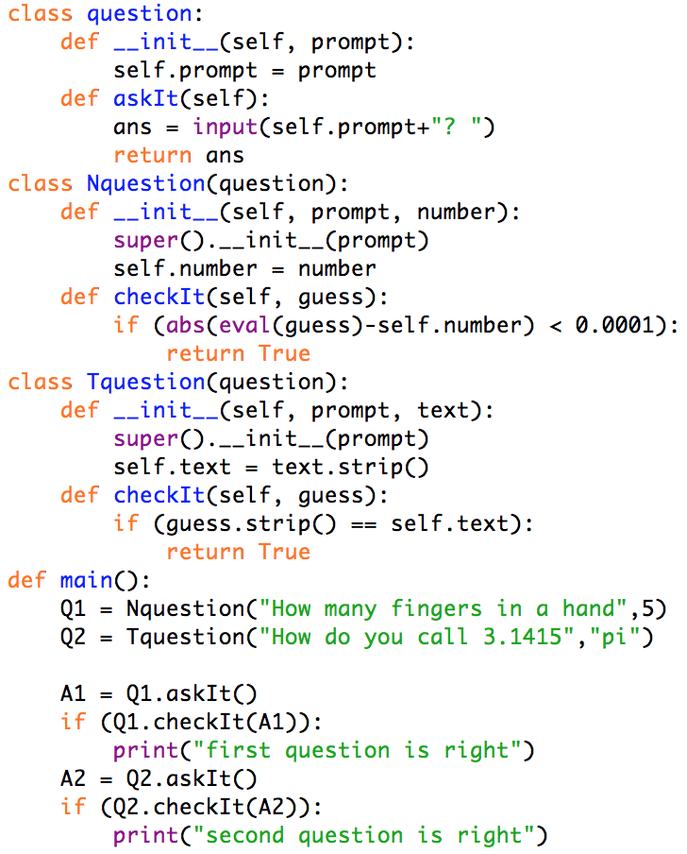
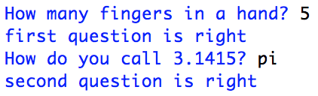
Inheritance
Code Reuse
Superclass - common
Instance Variable
self.prompt
Method
askIt()
Subclasses - specific
Instance Variables
self.number
self.text
Method
checkIt(guess)
Superclass constructor
super()

Slide 10
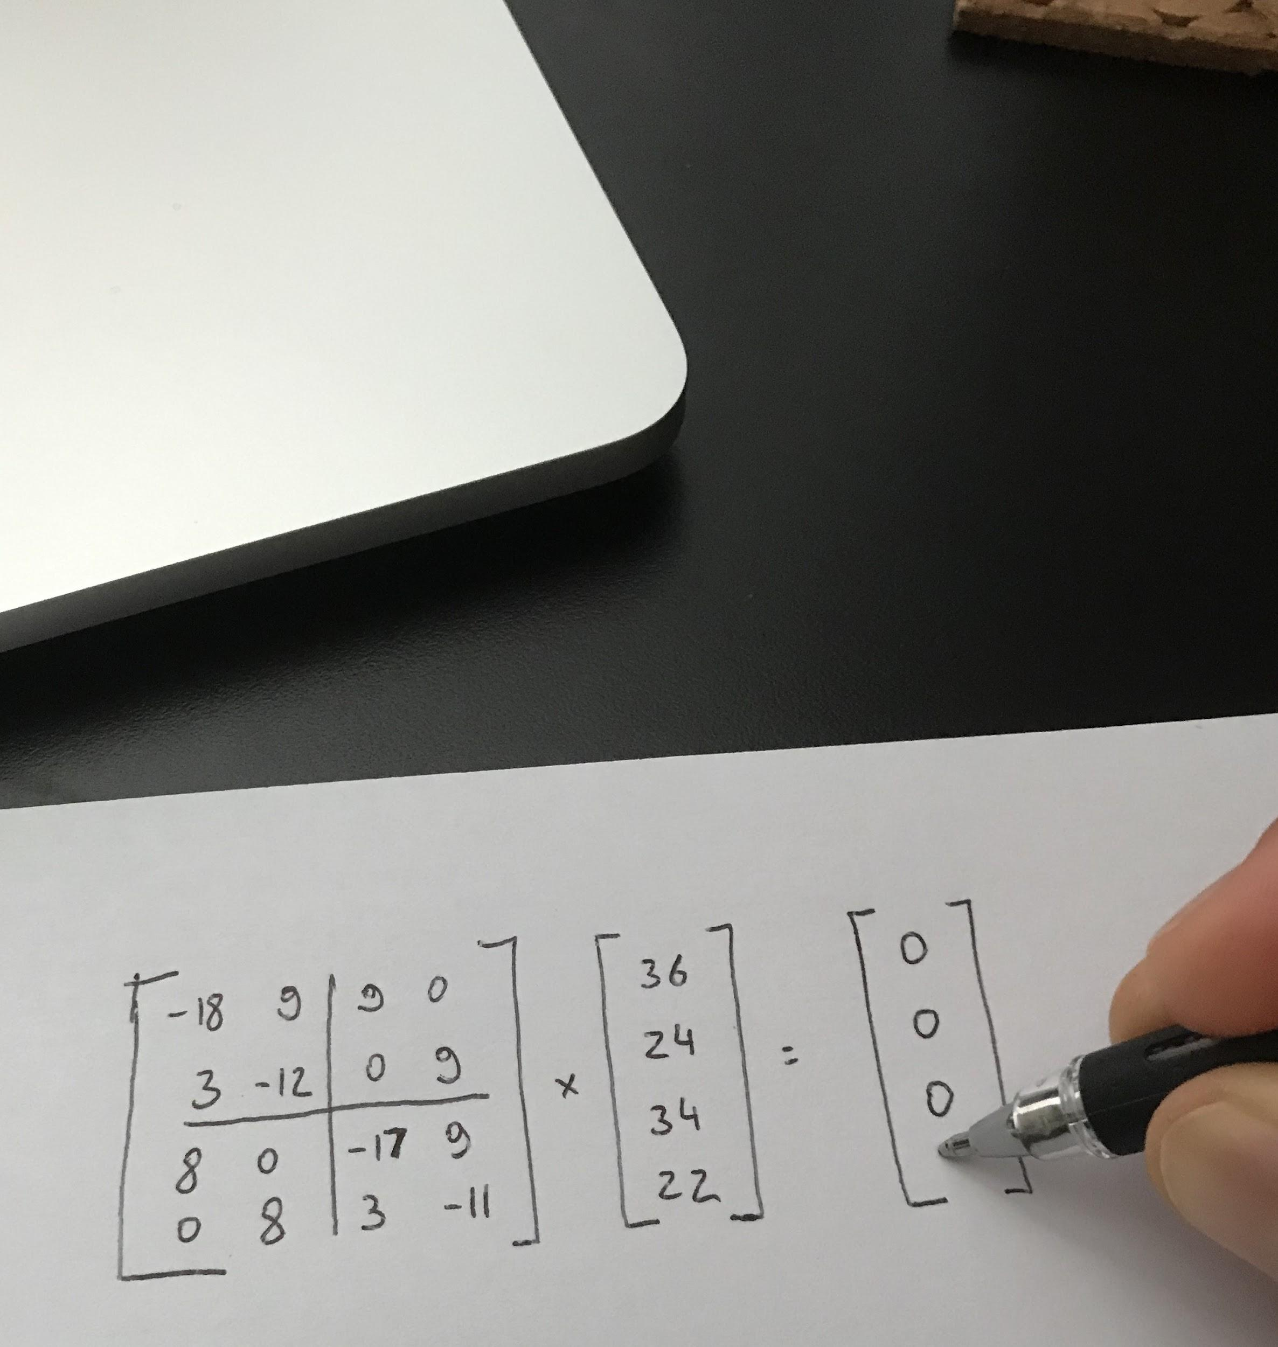

Object-Oriented Design
Guidelines
Look for candidates
Identify instance variables
Think about interfaces (methods)
Redefine the nontrivial methods
Use top-down design
Design iteratively
Use inheritance only when it means something
Try out alternatives
Keep it simple
Use patterns when you can, but no more than that

Slide 11
Static methods
A static method is not bound to a class or any instances of the class. In Python, you use static methods to group logically related functions in a class. To define a static method, you use the @staticmethod decorator.
Code language: Python (python)
To call a static method, you use the
ClassName.static_method_name()
syntax.
For example:
f = TemperatureConverter.celsius_to_fahrenheit(30)
print(f) # 86
class TemperatureConverter:
@staticmethod
def celsius_to_fahrenheit(c):
return 9 * c / 5 + 32
@staticmethod
def fahrenheit_to_celsius(f):
return 5 * (f - 32) / 9

Slide 12
Define class attributes
The following creates two instances of the Person class and shows the value of the counter:
p1 = Person('John', 25)
p2 = Person('Jane', 22)
print(Person.counter)
Code language: Python (python)
Output:
2
class Person:
counter = 0
def __init__(self, name, age):
self.name = name
self.age = age
def greet(self):
return "Hi, it's {self.name}."

Slide 13
Single Inheritance
The Person is the parent class while the Employee is a child class. To override the greet() method in the Person class, you can define the greet() method in the Employee class as follows:
class Employee(Person):
def __init__(self, name, age, job_title):
super().__init__(name, age)
self.job_title = job_title
def greet(self):
return super().greet() + f" I’m a {self.job_title}.”
you can define an Employee class that inherits from the Person class:
class Employee(Person):
def __init__(self, name, age, job_title):
super().__init__(name, age)
self.job_title = job_title
Inside the __init__ method of the Employee class calls the __init__method of the Person class to initialize the name and age attributes. The super() allows a child class to access a method of the parent class.

Slide 14
Single Inheritance (contd)
The following creates a new instance of the Employee class and call the greet() method:
employee = Employee('John', 25, 'Python Developer')
print(employee.greet())
Output:
Hi, it's John. I'm a Python Developer.

Slide 15
Introduction to the Python __init__() method
When you create a new object of a class, Python automatically calls the __init__() method to initialize the object’s attributes.
Python will use the method internally. In other words, you should not explicitly call this method.
Python will automatically call the __init__() method immediately after creating a new object, you can use the __init__() method to initialize the object’s attributes.
class Person:
def __init__(self, name, age):
self.name = name
self.age = age
if __name__ == '__main__’:
person = Person('John', 25)
print(f"I'm {person.name}. I'm {person.age} years old.")
Output:
I'm John. I'm 22 years old.

Slide 16
Python instance variables
class variables are bound to a class while instance variables are bound to a specific instance of a class. The instance variables are also called instance attributes.
class HtmlDocument:
version = 5
extension = 'html'
print(HtmlDocument.extension)
print(HtmlDocument.version)
class HtmlDocument:
version = 5
extension = 'html'
def __init__(self, name, contents):
self.name = name
self.contents = contents
blank = HtmlDocument('Blank', '')

Slide 17
Encapsulation (private attributes)
four fundamental concepts in object-oriented programming
Abstraction
Encapsulation
Inheritance
Polymorphism
Encapsulation: packing of data and functions that work on that data within a single object where we can hide the internal state of the object from the outside.
class isPrivateAttr:
def __init__(self):
self.__privateattr = 420
def printmyvar(self):
print(self.__privateattr)
a = isPrivateAttr()
a.printmyvar()
# this will not compile
#print(a.__privateattr)
# single _ is convention for private
# but NOT enforced!

Slide 18
Python static methods
static methods aren’t bound to an object. In other words, static methods cannot access and modify an object state
use static methods to define utility methods or group functions that have some logical relationships in a class.
To define a static method, you use the @staticmethod decorator
class TemperatureConverter:
@staticmethod
def celsius_to_fahrenheit(c):
return 9*c/5 + 32
@staticmethod
def fahrenheit_to_celsius(f):
return 5*(f-32)/9
To call the TemperatureConverter
class, you use the following:
f = TemperatureConverter.celsius_to_fahrenheit(35)

Slide 19
__str__ method to customize the string representation of an instance of a class
class Person:
def __init__(self, first_name, last_name, age):
self.first_name = first_name
self.last_name = last_name
self.age = age
def __str__(self):
return f'Person({self.first_name},{self.last_name},{self.age})'
when you use the print() function to print out an instance of the Person class, Python calls the __str__ method defined in the Person class.
person = Person('John', 'Doe', 25)
print(person)
Output:
Person(John,Doe,25)

Slide 20
__eq__ method to define the equality logic for comparing two objects using the equal operator (==)
john = Person('John', 'Doe', 25)
jane = Person('Jane', 'Doe', 25)
mary = Person('Mary', 'Doe', 27)
print(john == jane) # True
print(john == mary) # False
john = Person('John', 'Doe', 25)
print(john == 20) # False
class Person:
def __init__(self, first_name, last_name, age):
self.first_name = first_name
self.last_name = last_name
self.age = age
def __eq__(self, other):
if isinstance(other, Person):
return self.age == other.age
return False

Slide 21
SOLID in OOP
SOLID PRINCIPLES
Single Responsibility Principle
Open–closed principle
Liskov Substitution Principle
Interface Segregation Principle
Dependency Inversion Principle

Slide 22
Python Single Responsibility Principle
The purposes of SRP are to:
Create high cohesive and robust classes, methods, and functions.
Promote class composition
Avoid code duplication
class Person:
def __init__(self, name):
self.name = name
def __repr__(self):
return f'Person(name={self.name})'
@classmethod
def save(cls, person):
print(f'Save the {person} to the database')
if __name__ == '__main__':
p = Person('John Doe')
Person.save(p)
Person class has two jobs:
Manage the person’s property.
Store the person in the database.
Later, if you want to save the Person into different storage such as a file, you’ll need to change the save() method, which also changes the whole Person class.

Slide 23
SRP solution
To make the Person class conforms to the single responsibility principle, you’ll need to create another class that is in charge of storing the Person to a database.
class Person:
def __init__(self, name):
self.name = name
def __repr__(self):
return f'Person(name={self.name})’
class PersonDB:
def save(self, person):
print(f'Save the {person} to the database')
if __name__ == '__main__':
p = Person('John Doe')
db = PersonDB()
db.save(p)
In this design, we separate the Person class into two classes: Person and PersonDB:
The Person class is responsible for managing the person’s properties.
The PersonDB class is responsible for storing the person in the database.

Slide 24
SRP summary
Summary
The single responsibility principle (SRP) states that every class, method, or function should have only one job or one reason to change.
Use the single responsibility principle to separate classes, methods, and functions with the same reason for changes.

Slide 25
Python Open–closed principle
The open-closed principle states that a class, method, and function should be open for extension but closed for modification.
class Person:
def __init__(self, name):
self.name = name
def __repr__(self):
return f'Person(name={self.name})’
class PersonStorage:
def save_to_database(self, person):
print(f'Save the {person} to database')
def save_to_json(self, person):
print(f'Save the {person} to a JSON file')
if __name__ == '__main__':
person = Person('John Doe')
storage = PersonStorage()
storage.save_to_database(person)
In this example, the PersonStorage class has two methods:
The save_to_database() method saves a person to the database.
The save_to_json() method saves a person to a JSON file.
Later, if you want to save the Person’s object into an XML file, you must modify the PersonStorage class. It means that the PersonStorage class is not open for extension but modification. Hence, it violates the open-closed principle.

Slide 26
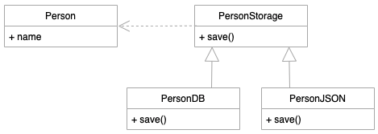
Open-Closed principle fix
To make the PersonStorage class conforms with the open-closed principle; you need to design the classes so that when you need to save the Person’s object into a different file format, you don’t need to modify it.

Slide 27
Open Closed principle fix
from abc import ABC, abstractmethod
class Person:
def __init__(self, name):
self.name = name
def __repr__(self):
return f'Person(name={self.name})'
class PersonStorage(ABC):
@abstractmethod
def save(self, person):
pass
class PersonDB(PersonStorage):
def save(self, person):
print(f'Save the {person} to database')
class PersonJSON(PersonStorage):
def save(self, person):
print(f'Save the {person} to a JSON file')
class PersonXML(PersonStorage):
def save(self, person):
print(f'Save the {person} to a XML file’)
if __name__ == '__main__':
person = Person('John Doe')
storage = PersonXML()
storage.save(person)
First, define the PersonStorage abstract class that contains the save() abstract method
Second, create two classes PersonDB and PersonJSON that save the Person object into the database and JSON file. These classes inherit from the PersonStorage class

Slide 28
Open Closed summary
Summary
The open-closed principle allows you to design the system so that it is open for extension but closed for modification.

Slide 29
Liskov Substitution principle
The Liskov substitution principle states that a child class must be substitutable for its parent class. Liskov substitution principle aims to ensure that the child class can assume the place of its parent class without causing any errors.
from abc import ABC, abstractmethod
class Notification(ABC):
@abstractmethod
def notify(self, message, email):
pass
class Email(Notification):
def notify(self, message, email):
print(f'Send {message} to {email}’)
class SMS(Notification):
def notify(self, message, phone):
print(f'Send {message} to {phone}')
if __name__ == '__main__':
notification = SMS()
notification.notify('Hello', 'john@test.com’)
we have three classes: Notification, Email, and SMS. The Email and SMS classes inherit from the Notification class.
The Notification abstract class has the notify() method that sends a message to an email.
The notify() method of the Email class sends a message to an email, which is fine.
However, the SMS class uses a phone number, not an email, for sending a message. Therefore, we need to change the signature of the notify() method of the SMS class to accept a phone number instead of an email.

Slide 30
Liskow Substition Principle fix 1
class Contact:
def __init__(self, name, email, phone):
self.name = name
self.email = email
self.phone = phone
class NotificationManager:
def __init__(self, notification, contact):
self.contact = contact
self.notification = notification
def send(self, message):
if isinstance(self.notification, Email):
self.notification.notify(message, contact.email)
elif isinstance(self.notification, SMS):
self.notification.notify(message, contact.phone)
else:
raise Exception('The notification is not suportd')
if __name__ == '__main__':
contact = Contact('John Doe', 'john@test.com', '(408)-888-9999')
notification_manager = NotificationManager(SMS(), contact)
notification_manager.send('Hello John')
To Conform with the Liskov substitution principle
redefine the notify() method of the Notification class so that it doesn’t include the email parameter
add the email parameter to the __init__ method of the Email class:
add the phone parameter to the __init__ method of the SMS class:
change the NotificationManager class:

Slide 31
Conform with Liskov Substitution Principle
from abc import ABC, abstractmethod
class Notification(ABC):
@abstractmethod
def notify(self, message):
pass
class Email(Notification):
def __init__(self, email):
self.email = email
def notify(self, message):
print(f'Send "{message}" to {self.email}')
class SMS(Notification):
def __init__(self, phone):
self.phone = phone
def notify(self, message):
print(f'Send "{message}" to {self.phone}')
class Contact:
def __init__(self, name, email, phone):
self.name = name
self.email = email
self.phone = phone
class NotificationManager:
def __init__(self, notification):
self.notification = notification
def send(self, message):
self.notification.notify(message)
if __name__ == '__main__':
contact = Contact('John Doe', 'john@test.com', '(408)-888-9999')
sms_notification = SMS(contact.phone)
email_notification = Email(contact.email)
notification_manager = NotificationManager(sms_notification)
notification_manager.send('Hello John')
notification_manager.notification = email_notification
notification_manager.send('Hi John')

Slide 32
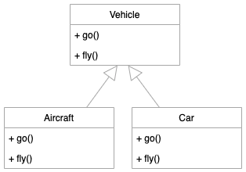
Python Interface Segregation Principle
Consider the following example:
The interface segregation principle states that an interface should be as small a possible in terms of cohesion. In other words, it should do ONE thing.
It doesn’t mean that the interface should have one method. An interface can have multiple cohesive methods.
A possible implementation:
from abc import ABC, abstractmethod
class Vehicle(ABC):
@abstractmethod
def go(self):
pass
@abstractmethod
def fly(self):
pass
class Aircraft(Vehicle):
def go(self):
print("Taxiing")
def fly(self):
print("Flying")
class Car(Vehicle):
def go(self):
print(”Driving")
def fly(self):
raise Exception('The car cannot fly')

Slide 33
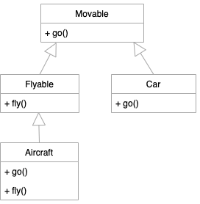
Interface Segregation Principle - solution
In this design the Car class must implement the fly() method from the Vehicle class that the Car class doesn’t use. Therefore, this design violates the interface segregation principle.
To fix this, you need to split the Vehicle class into small ones and inherits from these classes from the Aircraft and Car classes:
class Movable(ABC):
@abstractmethod
def go(self):
pass
class Flyable(Movable):
@abstractmethod
def fly(self):
pass
class Aircraft(Flyable):
def go(self):
print("Taxiing")
def fly(self):
print("Flying")
class Car(Movable):
def go(self):
print("Driving")

Slide 34
Interface Segregation Principle summary
In this design, the Car only need to implement the go() method that it needs. It doesn’t need to implement the fly() method that it doesn’t use.
Summary
The interface segregation principle advises that the interfaces should be small in terms of cohesions.
Make fine grained interfaces that are client-specific. Clients should not be forced to implement interfaces they do not use.

Slide 35
Python Dependency Inversion Principle
The dependency inversion principle states that:
High-level modules should not depend on low-level modules. Both should depend on abstractions.
Abstractions should not depend on details. Details should depend on abstractions.
See the following example:
class FXConverter:
def convert(self, from_currency, to_currency, amount):
print(f'{amount} {from_currency} = {amount * 1.2} {to_currency}')
return amount * 1.2
class App:
def start(self):
converter = FXConverter()
converter.convert('EUR', 'USD', 100)
if __name__ == '__main__':
app = App()
app.start()
In this example, we have two classes FXConverter and App
The App class has a start() method that uses an instance of the FXconverter class to convert 100 EUR to USD.
The App is a high-level module. However, The App depends heavily on the FXConverter class that is dependent on the FX’s API.

Slide 36
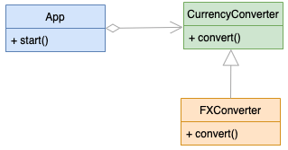
Dependency Inversion Principle fix
In the future, if the FX’s API changes, it’ll break the code. Also, if you want to use a different API, you’ll need to change the App class.
To prevent this, you need to invert the dependency so that the FXConverter class needs to adapt to the App class.
To do that, you define an interface and make the App dependent on it instead of FXConverter class. And then you change the FXConverter to comply with the interface.
from abc import ABC
class CurrencyConverter(ABC):
def convert(self, from_currency, to_currency, amount) -> float:
pass
class FXConverter(CurrencyConverter):
def convert(self, from_currency, to_currency, amount) -> float:
print('Converting currency using FX API')
print(f'{amount} {from_currency} = {amount * 1.2} {to_currency}')
return amount * 1.15
class AlphaConverter(CurrencyConverter):
def convert(self, from_currency, to_currency, amount) -> float:
print('Converting currency using Alpha API')
print(f'{amount} {from_currency} = {amount * 1.2} {to_currency}')
return amount * 1.2
class App:
def __init__(self, converter: CurrencyConverter):
self.converter = converter
def start(self):
self.converter.convert('EUR', 'USD', 100)

Slide 37
Dependency Inversion Principle summary
Main function:
if __name__ == '__main__':
converter = AlphaConverter()
app = App(converter)
app.start()
Summary
Use the dependency inversion principle to make your code more robust by making the high-level module dependent on the abstraction, not the concrete implementation.

